Slide 1
Net-Zero and other Emission Reduction Target Pitfalls and the Rising Focus on Greenwashing
June 8, 2023

Slide 2
Understanding Greenwashing

Slide 3
What is Greenwashing Anyway?
Understanding Greenwashing
The concept of “greenwashing” refers to false or misleading statements about the environmental impacts or sustainability of a particular practice or activity
It does not need to be tied to a specific product, but can relate to broader corporate positioning around sustainability or other ESG matters
“Green” claims are of importance to stakeholders who increasingly seek to align their purchase choices with companies that share their values
Companies are feeling increasing pressure by shareholders and other stakeholders to tout green bona fides, but this leads to risks
Even if well-meaning, companies face difficulties in producing and accessing relevant, high-quality sustainability data
Intention of party making claim not relevant – purposeful deception not an element of greenwashing claim

Slide 4
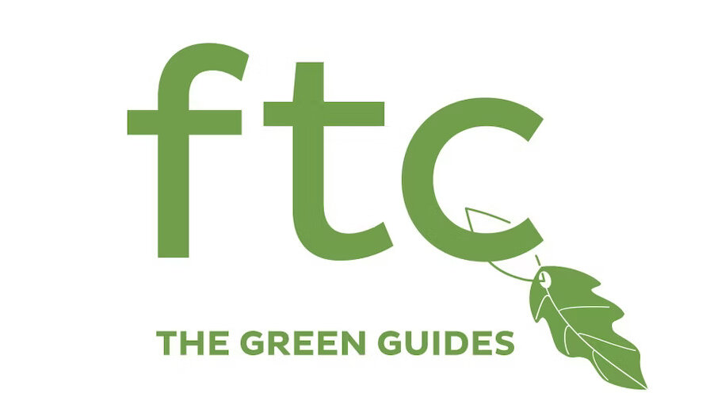
Green Guides Overview
Understanding Greenwashing
What are they:
Formally called “Guides for the Use of Environmental Claims”
Administrative interpretations of the law, but they are not independently enforceable or legally binding
They can be used as affirmative defense and some states have adopted the guides to help define their own laws against fraudulent consumer marketing
The current version of the Green Guides is from 2012, but FTC opened them up for review and public comment in December 2022.
The FTC first issued the Green Guides in 1992 and subsequently revised in 1996, 1998, and most recently in 2012.
The SEC recently described “greenwashing” as occurring when companies “exaggerate their ESG practices or the extent to which their investment products or services take into account ESG factors.”
The overall emphasis with the Green Guides is that consumers cannot reasonably substantiate claims like eco-friendly, sustainable, carbon neutral, recyclable, and the like.
Updates are coming. And with it, likely more litigation.
“Walk down the aisle at any major store—you're likely to see packages trumpeting their low carbon footprint, their energy efficiency, or their quote-unquote ‘sustainability.’ For the average consumer, it’s impossible to verify these claims . . . To be effective, the Green Guides have to keep up with developments in both science and consumer perception. That's why the Commission is commencing a regulatory review of the guides.”
- Lina Khan, FTC Chair

Slide 5
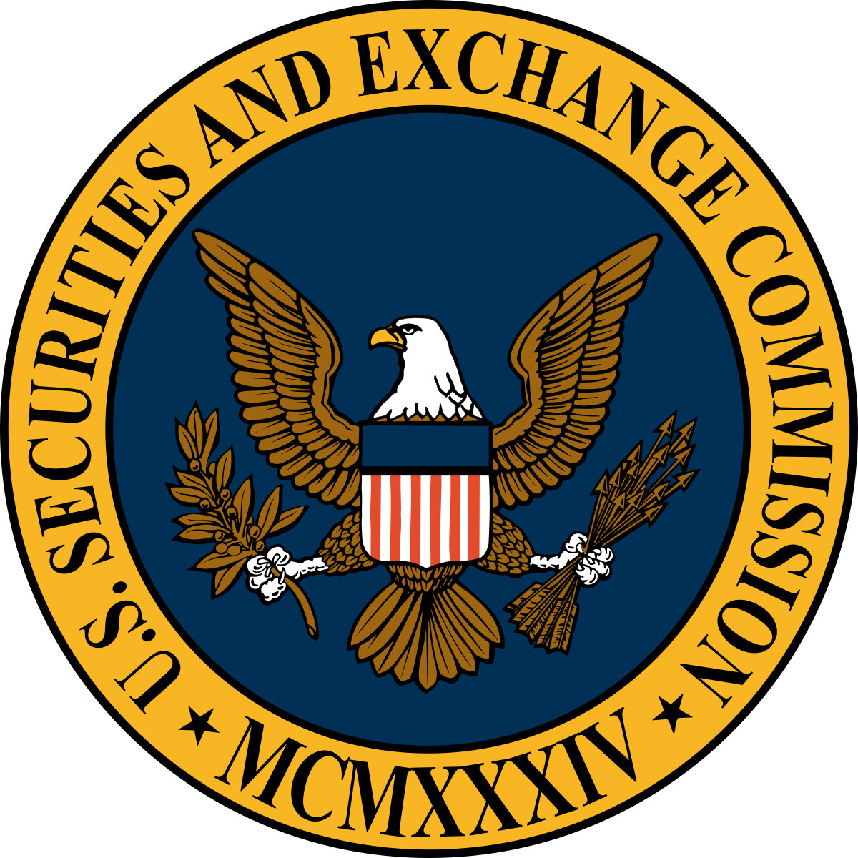
Who are the greenwashing police?
Understanding Greenwashing
Enforced by the FTC, SEC, market participants (through National Advertising Division (NAD)), State AGs, private litigants
Developing and asserting claims related to greenwashing also appears to be a major priority for NGOs and could become an area of focus for government enforcement.
Claims don’t even need to be conventional “claims” for greenwashing allegations
Corporate ESG initiatives are not immune from greenwashing claims
Use of voluntary carbon offsets, which are largely unregulated, will likely be a particular focus for greenwashing claims
?
“Group sues to hold Coca-Cola, Pepsi and others liable for plastics fouling California waters”
“EPA looks to toss ‘deceptive’ plastics recycling symbol”

Slide 6
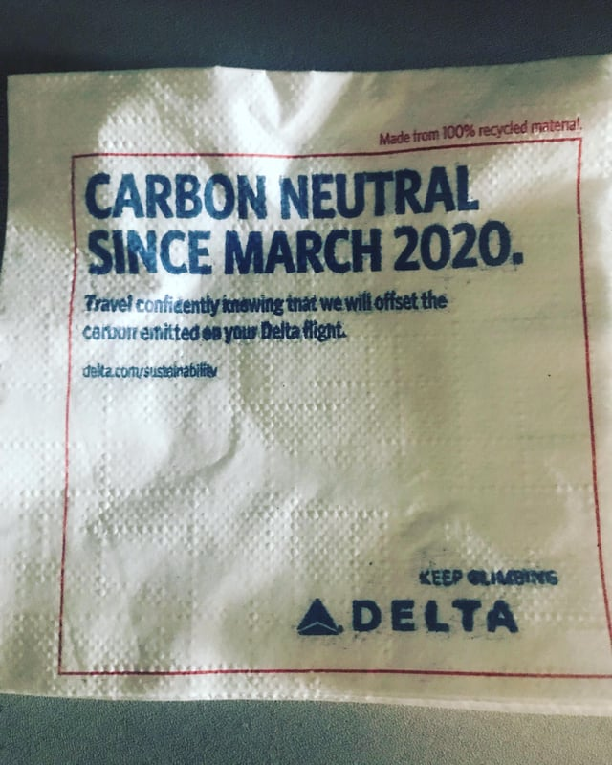
Greenwashing in the ESG context
Understanding Greenwashing
Stakeholders have been pressuring companies to take aggressive action on climate in recent years, and many have.
These ambitions now appear via non-traditional “marketing” efforts, like enterprise ESG goals and sustainability reports.
They are not immune from greenwashing claims
Aspirations (like net zero by 2050) are not mere “puffery”
Plausible plans, efforts and timelines must exist
TBD where recent high-profile allegations land, but scrutiny is ramping up
“Delta Air Lines Sued Over Carbon Neutrality Claims”
“Delta's carbon-neutral pledge is 'greenwashing,' California lawsuit says”
“Revealed: more than 90% of rainforest carbon offsets by biggest certifier are worthless, analysis shows”

Slide 7
Carbon Offsets Explained

Slide 8
What is a “carbon offset credit”?
Offsets Explained
A certificate that represents one metric ton of carbon dioxide equivalent that is either prevented from being emitted or removed from the atmosphere through a carbon-reduction project, purchased to offset personal or industrial emissions.
An independent third party must certify and verify carbon offset credits before they are valid.
Once verified and certified, carbon offset credits can be purchased and traded.
Third Party Verification
Carbon Offset Credits
Carbon Offsetter
$$$

Slide 9
Carbon Offset Certification: Voluntary Markets
Offsets Explained
Real
Results in actual carbon reduction, not relocation of emissions
Independent providers each have their own criteria
Measurable
Each credit should represent one metric ton of greenhouse gas
Permanent
Reduction will continue for entire certification period
Additional
Carbon reduction would not have happened without the offset
Ongoing efforts to centrally regulate to create fungible, trustworthy products
Independently Verified
Multiple independent verifiers operate in the market
Unique
No double-counting offsets
Notes:
https://indices.ihsmarkit.com/#/Carbonindex

Slide 10
Types of Carbon Offset
Offsets Explained
AVOID EMISSIONS
REMOVE EMISSIONS
Avoidance / Preservation
(e.g., increased efficiency; paying a
landowner to not cut down trees)
Reforestation
(planting trees in denuded areas and areas that have not previously been planted)
Renewable generation
(can be measured by renewable
energy certificates (“RECs”)
Direct air capture
with carbon storage
(e.g., smokestack capture with pipeline
to underground storage)

Slide 11
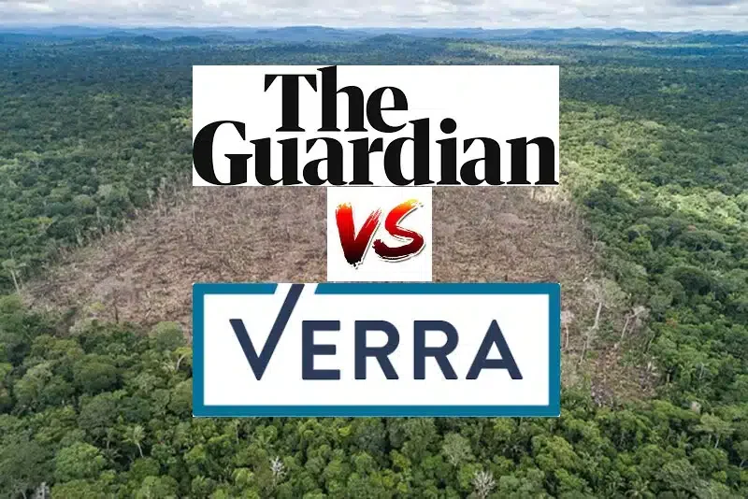
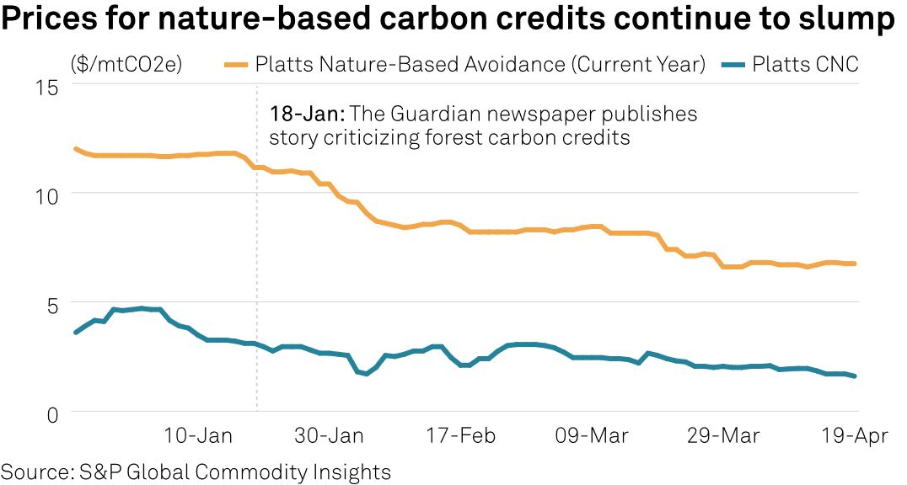
Growing Criticism and Scrutiny
Offsets Explained
Notes:
Platts CNC, an assessment that reflects the most competitive nature-based carbon credit prices, was assessed at an all-time low of $1.60/mtCO2e April 19. Platts CNC averaged $9.55/mtC02e in 2022, according to data from S&P Global.

Slide 12
Is Net Zero Right for You

Slide 13
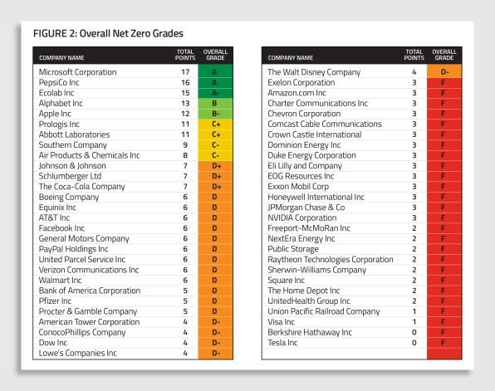
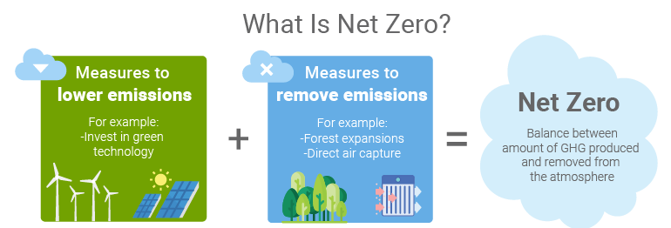
What is Net Zero?
Is Net Zero Right for You
Source: As You Sow

Slide 14
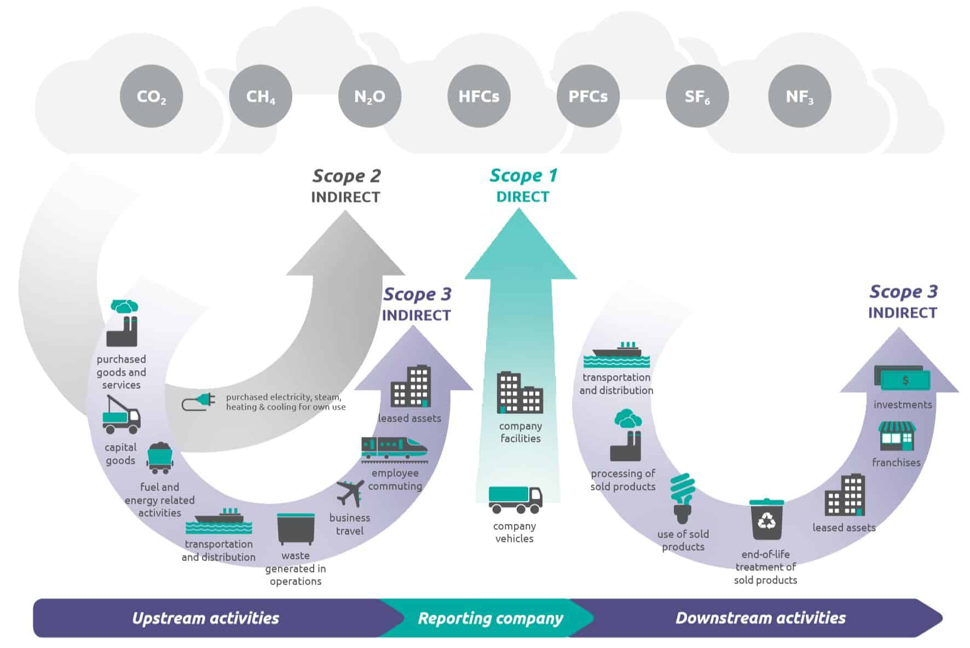
Greenhouse Gas Emissions
Is Net Zero Right for You
Scope 1 → Emissions are direct GHG emissions from operations that are owned or operated by the company
Scope 2 → Emissions are indirect GHG emissions from the generation or purchased or acquired electricity, steam, heat, or cooling that is consumed by operations owned or controlled by a company
Scope 3 → Emissions are indirect GHG emissions from all upstream and downstream activities in a company’s value chain

Slide 15
When will net zero be achieved?
Is Net Zero Right for You
Points to consider when selecting an endpoint:
What is a feasible trajectory?
Do you want to exceed, match or follow the IEA or other trajectory?
Which years to do expect steep changes in emissions to occur?
What is an acceptable volume of emissions to offset?
What are others in your sector / adjacent sectors doing?
=
Volume of offsets required

Slide 16
Legal Risks of a Net Zero Commitment
Is Net Zero Right for You
Item 1502(e): Carbon Price
Item 1502(f): Climate Scenario Analysis
Description of the scenarios
Description of all parameters, assumptions, analytical choices, and the projected principal financial impacts on the registrant’s business strategy under each scenario
Item 1503(c): Transition Plan
Item 1506: Climate Targets and Goals
Any targets related to
Emissions
Energy Usage
Water Usage
Conservation
Ecosystem Restoration
Revenues from Low-Carbon Products
Use of Carbon Offsets or RECs to meet targets

Slide 17
“Greenwashing” and Offsets – Disputes Have Already Started
Is Net Zero Right for You
Delta Airlines sued in class action for purportedly overstating its carbon neutrality, which is heavily premised on purchasing carbon offsets.
KLM Royal Dutch airlines recently sued by environmental groups for allegedly exaggerating benefits of carbon offsets offered to passengers for purchase.
Washington DC utility sued by environmental groups for multiple greenwashing claims, including false-advertising related to offsetting claims and claims that RNG is a “zero carbon fuel.”
Danone Waters of North America sued over its carbon-neutral claim on packaging and labels for its Evian water brand. (Dorris v. Danone Waters of Am., No. 7:22-cv-08717 (S.D.N.Y.)), plaintiffs alleged that Evian’s “carbon-neutral” representation did not cover Company’s entire footprint (i.e., manufacturing).
Allbirds sued by consumer alleging that Allbirds’s shoes were misleadingly labeled as having a low carbon footprint because the company’s methodology didn’t account for value chain emisisons (Dwyer v. Allbirds, Inc., No. 7:21-cv-05238, 2022 WL 1136799, at *2 (S.D.N.Y. Apr. 18, 2022).

Slide 18
Legal Risks of a Net Zero Commitment
Is Net Zero Right for You
Inconsistency between Net Zero commitment and other public disclosures
Inadequate basis for making public statements regarding Net Zero or insufficient analysis of the path to attain it
Challenges to investment or operational decisions (e.g., opening or expanding a facility that emits GHG) as inconsistent with public disclosures regarding Net Zero
Accounting issues (i.e., valuing assets in ways inconsistent with the steps that must be taken to attain Net Zero, for example if some operations will need early shutdown or production curtailment)
What happens if a company changes its mind?

Slide 19
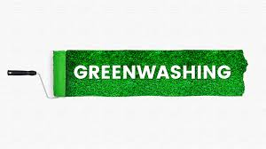
Net Zero Litigation – what might the issues be?
Is Net Zero Right for You
Does a company have a plausible path to Net Zero based on current technologies?
Are a company’s assumptions about availability and cost of offsets physically and economically plausible? Is the validity of these assumptions monitored?
To what extent is a company’s Net Zero commitment caveated based on technological and economic considerations?
Should a company explicitly identify risk factors that might prevent it from delivering on a Net Zero commitment?
Is it worth considering an explicit off-ramp from a Net Zero commitment, for example, based on developments beyond a company’s control?
Are the assumptions underlying a company’s disclosures on non-ESG issues (financial performance, valuation of assets, etc.) consistent with its Net Zero commitment?

Slide 20
Net Zero Commitments – our bottom line regarding enforcement risk
Is Net Zero Right for You
Legal risks are impossible to entirely avoid; manage and plan accordingly
Most of the risks associated with a Net Zero commitment appear manageable if the disclosure is appropriately caveated, a company maintains evidence that it has a plausible path to get there (even if delivery is uncertain), and the commitment explicitly addresses potential changes in course.
Managing these issues now will reduce risk if there is later controversy regarding the basis for, or accuracy of, a company’s statements regarding Net Zero.
Message internally now so that stakeholders understand risks

Slide 21
Takeaways from the SEC Division of Examination April 2021 Risk Alert on Avoiding Greenwashing
Standardization of terms. Ensure the company’s marketing and disclosure practices demonstrate a clear, standardized understanding of “ESG” and utilize consistent terminology to avoid misrepresentation, whether through false and misleading statements or simple confusion. Relatedly, substantiate the claims the company makes to include documentation (g., research, selection, monitoring, and, where applicable, due diligence), clear records, and robust written policies and procedures.
Be transparent as to the company’s ESG strategy. Make it clear to investors how ESG informs company decisions and how those metrics are measured.
Be consistent. Align disclosures concerning ESG approaches and strategies, as well as between actual company practice and marketing. Equally important: ensure that marketing, practices, and disclosures are updated as ESG strategies, approaches, and investing develop.
Evaluate and adjust internal compliance and controls to adequately address ESG issues. A company should develop, implement, and update all applicable policies and procedures regarding its ESG strategies to address, as appropriate, investing, analyses, processes, monitoring, and compliance. Additionally, a company’s internal compliance should ensure accuracy and consistency is present across management practices and ESG-related disclosures.
Educate personnel. The importance of training a company’s personnel on relevant ESG issues, such as disclosures, cannot be overstated. Knowledge is key here.

Slide 22
Greenwashing and Net-Zero: What Does the Board Need to Know

Slide 23
Net Zero Governance – General
What Does the Board Need to Know
Strong governance oversight is essential to ensure that accountability for achieving net zero goals is incorporated throughout the company, starting from the top
Companies should ensure that governance frameworks are in place to enable decision-making on the basis of meeting long-term net zero ambitions
It is essential that those at the highest levels of the organization, i.e., the company’s management and board of directors, bring a mix of informed perspectives that enable effective long-term decision-making regarding net zero commitments
Those at the highest levels of the company assume responsibility for delivering net zero transformation
Climate change and the net zero transition, is a foreseeable financial risk and opportunity within mainstream investment and planning horizons, so management and the board of directors should be accountable for the company’s net zero transition in the same way they are for other company decisions about long-term strategy
This will help ensure the long-term resilience, viability and success of the business

Slide 24
Net Zero Governance – Board of Directors
What Does the Board Need to Know
Incorporating Net Zero into the Board’s Oversight Duties
Boards should ensure that net zero considerations systemically inform near-term and long-term strategic planning and decision-making processes
Boards should ensure that net zero considerations are embedded into the management of risks and opportunities across the company
Four Core Areas of Board Oversight of Net Zero
Understanding net zero risks and opportunities
Includes integrating net zero considerations into the company’s ERM and considering net zero opportunities and innovation
Understanding net zero in relation to the company’s strategy
Includes financing and investment needs; metrics, KPIs, and management incentives; key milestones and continuous assessment; and emissions in the value chain
Assessing the existing governance and oversight structure
Includes board and committee oversight responsibility, frequency and topics on the board agenda, board skills and expertise, board access to experts, continuous education, and management reporting to the board
Understanding the company’s reporting strategy
Includes voluntary and detailed disclosures, accountability and progress, data accuracy, systems processes and controls, and assurances

Slide 25
Use INSIGHT photo
(color)
V&E Profile
Matthew Dobbins
Partner — Environmental & Natural Resources
Houston │ +1.713.758.2026 │ mdobbins@velaw.com
Matthew has a national practice spanning every major environmental statute, and has been recognized for his expertise in the areas of environmental litigation, regulation and transactional matters by the Legal 500. Matthew’s practice focuses on complex regulatory counseling, remedial issues, environmental litigation, navigating the energy transition, and environmental transactional matters. He has extensive experience advising clients engaged in low-carbon ventures, including permitting issues in connection with carbon capture and sequestration (CCS) projects, negative emissions projects, and renewable fuels and credits (e.g., EPA RFS and California LCFS). He also counsels clients on matters related to infrastructure development, including pipeline safety regulations. He routinely counsels private equity, financial institutions, and public and private company clients on environmental liabilities across an array of industries, including all segments of the oil and gas sector, renewable power and fuels, waste recycling and disposal, and the mining, chemicals, and paper industries.

Slide 26
Use INSIGHT photo
(color)
V&E Profile
Jon Solorzano
Counsel — Environmental, Social & Governance
Los Angeles │ +1.213.527.6427 │ jsolorzano@velaw.com
Jon’s practice focuses on advising public and private companies and their boards of directors and executive teams on matters and opportunities related to environmental, social and governance (ESG), corporate governance, sustainability considerations, shareholder activism, risk management, securities law and M&A. As Senior Director, Legal and Corporate Development for The Clorox Company from 2015 through 2022, he helped build and manage a comprehensive ESG program and helped lead the company’s ESG strategy, stakeholder engagement and ESG reporting. He also helped establish and execute strategies around climate change, plastics and waste, supply chain transparency and diversity and inclusion. Jon advises clients, including public companies, on securities disclosure, corporate governance and compliance matters. Jon plays a strategic role in advising clients on a broad range of ESG issues and related risks, including the development of sustainability reporting, corporate ESG programs and governance oversight and the establishment of greenhouse gas (GHG) emissions reductions targets, plastics and waste goals, product safety and stewardship principles, and diversity and inclusion priorities. Jon’s valuable in-house background brings a unique and pragmatic perspective to clients assessing and incorporating ESG practices into their corporate strategies. He serves as Co-Head of V&E’s ESG Taskforce.

Slide 27
Use INSIGHT photo
(color)
V&E Profile
Corinne Snow
Counsel — Environmental, Social & Governance
Washington │ +1.212.237.0157 │ csnow@velaw.com
Corinne helps clients understand how their environmental and climate disclosures will interact with existing and forthcoming regulatory requirements and how to limit legal liability risks related to those disclosures. With a strong background in litigation challenging or defending federal regulations, advising on regulatory compliance, internal investigations, and defense against government investigations and enforcement actions, she provides clients with practical advice on how to prepare for and shape new regulations, how to distill and effectively communicate requirements within an organization, and how to manage communications with regulators. Corinne spent several years in the U.S. Department of Justice, including as the Chief of Staff for the Environment and Natural Resource Division where she was involved in formulating the defense of numerous federal regulations, agency decisions, and permits for infrastructure projects. She also worked closely with the General Counsel’s Offices for EPA, Departments of Interior, Defense, Energy, Commerce, and Agriculture, as well as the White House and Counsel on Environmental Quality to advise high-ranking officials on policy and litigation risks associated with the environmental, climate, and natural resource laws. She is a leading member of V&E’s PFAS Task Force.

