Slide 1
Global Report
Notes:
Welcome to the 2023 Edelman Trust Barometer. Around this time last year, we were an exit from the pandemic and economic boom. What we got was armed conflict in Ukraine upsetting geopolitics and triggering the specter of food shortages and large scale war. Climate shocks ranging from flooding to drought cost many billions in damages and made daily life nearly impossible in regions around the world. Meanwhile, inflation made just about everyone less confident about their financial future, flaring worries that they’d have to choose between heating and eating. Polarization led to political unrest. All these major events underline how complex and interconnected our world is. With the 2023 Edelman Trust Barometer, we seek to embrace that fact.
Images (from top left to right): Queen Elizabeth visits Drapers’ Hall in London; supporters of Brazilian former President Jair Bolsonaro invade Planalto Presidential Palace in Brasilia, Brazil; Ukrainian President Volodymyr Zelensky speaks at a joint UN press conference in Kyiv, Ukraine; Pakistani naval personnel rescue flood-affected people; protesters hold banner during solidarity demonstration in memory of Mahsa Amini in Krakow, Poland; Elon Musk announces bid for purchasing Twitter; Sam Bankman-Fried, CEO of FTX, testifies at US congressional hearing; health workers in China disinfect community amid increasing measures to control COVID outbreaks.

Slide 2
2023 Edelman Trust Barometer
Methodology
Global averages
These vary based on the number of
countries surveyed each year:
*To protect the stability of the global average, Sweden will not be included in the average until there are at least two years of recent data
The sensitive nature of the question prevented this
data from being collected in these countries
Statistical significance
All indicated year-over-year significant changes were determined using a t-test set at a 99%+ confidence level
Annual online survey in its 23rd year
Fieldwork conducted: Nov 1 – Nov 28, 2022
GLOBAL 27
28
32,000+
1,150+/-
GLOBAL 25 Excludes China and Thailand
Countries
Respondents
Respondents per country**
Argentina
Australia
Brazil
Canada
China
Colombia
France
Germany
India
Indonesia
Ireland
Italy
Japan
Kenya
Malaysia
Mexico
Nigeria
Saudi Arabia
Singapore
S. Africa
S. Korea
Spain
*Sweden
Thailand
The Netherlands
UAE
UK
U.S.
-
0
+
Significant change
Russia, part of the Edelman Trust Barometer from 2007 to 2022, was not included in this wave
For more details on global averages and country-specific methodology, please refer to the Technical Appendix
Due to a translation inconsistency, the France data measuring trust in government, as well as competence and ethics was removed from certain slides. For more details contact the Trust Barometer research team
**The sample size varies by country from 1,082 to 1,500.
27-market global data margin of error: General population +/- 0.6 percentage points (n=31,171)
Country-specific data margin of error: General population +/- 2.5 to 3.0 percentage points (varies by country based on sample size, n=1,082 to n=1,500)
Notes:
The Trust Barometer is in its 23rd year – now fielded in 28 countries on six continents, with an average of 1,150 respondents per country.
The surveys were fielded near the end of 2022, from the first to 28th of November.
Pay attention, as we go through the presentation, we clearly go through where the global averages changes to have a consistent year to year trendline or where we’re not able to ask questions that are sensitive to certain markets.
Also new this year, we’re noting statistical significance with a highlighted circle as displayed on the right. This simply means that the year over year change indicated is very unlikely to be due to a random data fluctuation.

Slide 3
Trust
Shifts from “Authorities”
to Peers
Rising Influence
of NGOs
Trust in Business Plummets
Crisis of Leadership
Trust in
Crisis
Business
Most Trusted
2001
2005
2009
2013
2017
2021
Navigating a
Polarized World
Earned Media More Credible than Advertising
Business More Trusted
than Government
and Media
Business Must Partner With Government to Regain Trust
Trust is
Essential to Innovation
2023
Trust
at Work
23
2003
2007
2011
2015
2019
Years
of
Trust
2004
2008
2012
2016
2020
U.S. Companies in Europe Suffer Trust Discount
Young People Have More Trust in Business
Fall of Government
Growing Inequality
of Trust
Trust: Competence
and Ethics
2002
2006
2010
2014
2018
2022
Fall of the Celebrity CEO
A “Person Like Me” Emerges as Credible Spokesperson
Performance and Transparency Essential to Trust
Business to
Lead the Debate
for Change
The Battle
for Truth
The Cycle
of Distrust
Notes:
In two decades of research, we have documented many trends in trust. More recently, we have seen transparency, disinformation and cyclical distrust all serve as central themes of the Trust Barometer. Indeed, these themes have given rise to our area of inquiry for this report: polarization. As we’ll discuss shortly, polarization – usually thought of as a political issue – has huge impacts for business, from employee base to customer base to brand positioning.

Slide 4

Facing Economic
Fears Without a
Trust Safety Net
Notes:
One of our major findings this year is a massive change in global economic sentiment. The pocketbook picture isn’t pretty.
Image: A woman checks her receipt at a supermarket in Serbia.

Slide 5
Economic Optimism Collapses
Percent who say
GLOBAL 24
-
0
+
Significant change
24 of 28 countries at all-time lows
Developed countries
My family and I will be better off in five years
-10
pts
l | l | l | l | l | l | l | l | l | l | l | l | l | l | l | l | l | l | l | l | l | l | l | l | l | l | l | l
Change,
2022 to 2023
-6 | -6 | -7 | -9 | -10 | -7 | -10 | -6 | -11 | n/a | -11 | -11 | -20 | -7 | -4 | -17 | -13 | -11 | -15 | -2 | -22 | -9 | +1 | -19 | -6 | -7 | -8 | -11
2023 Edelman Trust Barometer. CNG_FUT. Thinking about the economic prospects for yourself and your family, how do you think you and your family will be doing in five years’ time? 5-point scale; top 2 box, better off. General population, 24-mkt avg. *Sweden is not included in the global average. Year-over-year changes were tested for significance using a t-test set at the 99%+ confidence level.
Notes:
In fact, there has been a dramatic collapse in economic optimism around the world. We asked people about how they felt about their economics prospects – did they think that they and their families will be better off in five years. Responses to this question had been steady for a while, but over the last year, we saw a drastic 10 point drop. A stunning 24 of the 28 countries surveyed are reporting all-time lows, including every developed market. This means that globally, people are much less excited about their financial prospects than they were a year ago. And as we’ll see, that sets up an environment of polarization.

Slide 6
Personal Anxieties On Par With Existential Fears
Percent who worry about …
Personal
economic fears
Existential
societal fears
2023 Edelman Trust Barometer. POP_EMO. Some people say they worry about many things while others say they have few concerns. We are interested in what you worry about. Specifically, how much do you worry about each of the following?
9-point scale; top 4 box, worry. Some attributes asked of half of the sample. General population, 27-mkt avg. Job loss asked of those who are an employee of an organization (Q43/1). Job loss is a net of attributes 1-3, 5, and 22-24.
Notes:
That economic fear is one log on a bigger fire of fears and anxieties. Indeed, we see that economic fears – whether you’ll lose your job or if inflation will make things less affordable – match large scale, survival-related fears that affect the breadth of society, like climate change, nuclear war, or resource shortages. People are dealing with a lot of fear, both day-to-day and long-term issues. So with all this fear, who do we turn to for stability?

Slide 7
Business Only Trusted Institution
Percent trust
GLOBAL 26 excludes France
Significant chg | Not significant chg
-
0
+
Significant change
Distrust
(1-49)
Neutral
(50-59)
Trust
(60-100)
l | l | l | l
Change,
2022 to 2023
-1 | -1 | -1 | -2
Least-trusting countries for each institution |  | Spain Japan S. Korea | 49 47 38 |  | *Sweden Germany Japan | 44 41 38 |  | Japan S. Africa Argentina | 33 22 20 | UK Japan S. Korea | 37 34 27
2023 Edelman Trust Barometer. TRU_INS. Below is a list of institutions. For each one, please indicate how much you trust that institution to do what is right. 9-point scale; top 4 box, trust. General population, 26-mkt avg. *Sweden is not included in the global average. Year-over-year changes were tested for significance using a t-test set at the 99%+ confidence level.
Due to a translation inconsistency, the France data was removed from this slide. For more details contact the Trust Barometer research team.
Notes:
After reviewing this environment of fear, we move to trust. Business remains our only trusted institution at 62 points. NGOs and Media both fell by a point year-over-year, while government stayed the same. Looking at the table below the charts, we see which countries are least trusting of given institutions. South Korea is the most skeptical of business, Germany distrustful of NGOs, Argentina – following a year of economic tumult – is very low on government at just 20 points, and the UK is relatively low on Media. The upshot: Business is uniquely positioned, with some unique responsibilities.

Slide 8
Government and Media Fuel Cycle of Distrust,
Seen as Sources of Misleading Information
Percent who say
GLOBAL 25 Excludes China and Thailand
These institutions are
a source of false or misleading information
a reliable source of
trustworthy information
2023 Edelman Trust Barometer. [INS]_PER_DIM. In thinking about why you do or do not trust [institution], please specify where you think they fall on the scale between the two opposing descriptions. 11-point scale; top 5 box, positive; bottom 5 box, negative. Media and NGOs shown to half of the sample. General population, 25-mkt avg. Data not collected in China and Thailand.
Notes:
What could be driving down these trust scores? We asked people about whether the four institutions provided more misleading or trustworthy information. Globally, our respondents said that government provided more false information than quality information. And media – traditionally the guardians of information – provided just as much unreliable as reliable info. Business and NGOs are both seen as providing much more trustworthy information.

Slide 9
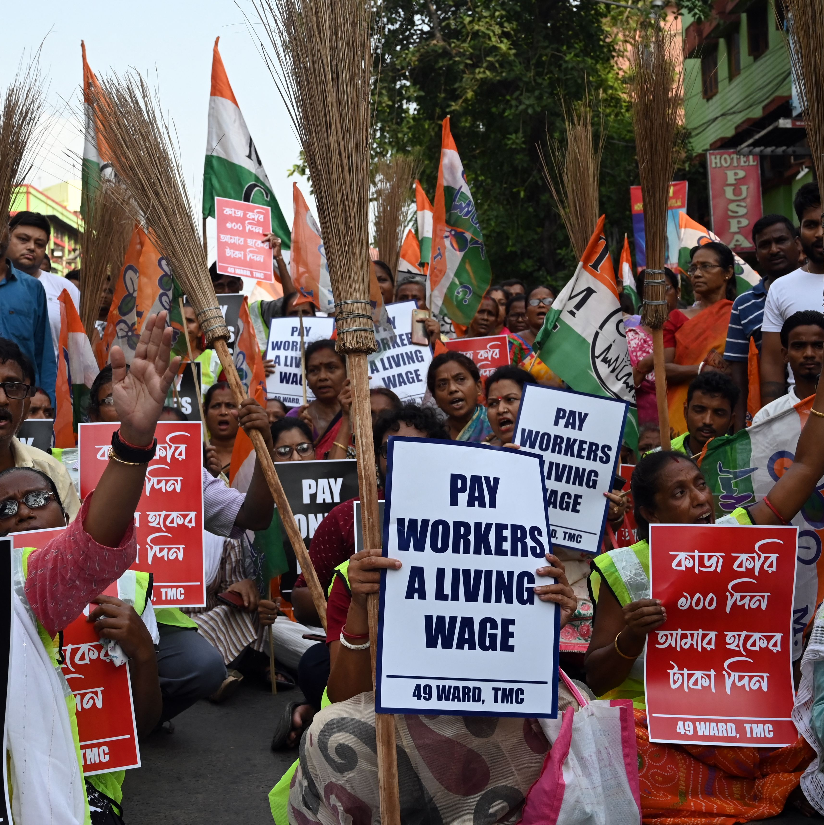
Great Expectations, Heightened Risk for Business
Notes:
And that brings us to our major tension. We’ve already discussed how business is so trusted. But we’ve also noted how prevalent and powerful polarization is, how much it seeps into different aspects of life. What happens when those two trends collide? It makes for a unique role: People expect more from business – and business faces higher risks.
Image: Supporters of the Trinamool Congress party in Kolkata, India, display banners and slogans against government policies.

Slide 10
Consumers and Employees Pressure Business to Stand Up for Them
Percent who say
2022 Edelman Trust Barometer Special Report:
The New Cascade of Influence
2022 Edelman Trust Barometer Special Report:
Trust In the Workplace
I buy or advocate for brands based on
my beliefs and values
Having societal impact is a strong expectation or deal breaker when considering a job (avg)
GLOBAL 14
GLOBAL 7
63
Among employees
63
69
Business reflects my values
Has a greater purpose
Meaningful work that shapes society
Opportunities to address social problems
Stops specific business practices if employees object
CEO addresses controversial issues I care about
%
%
%
2022 Edelman Trust Barometer Special Report: The New Cascade of Influence. Belief-driven consumers. General population, 14-mkt avg. Please see the Technical Appendix for full explanation of how belief-driven consumers were measured. 2022 Edelman Trust Barometer Special Report: Trust in the Workplace. EMP_IMP. When considering an organization as a potential place of employment, how important is each of the following to you in deciding whether or not you would accept a job offer there? 3-point scale; top 2 box, important. 7-mkt avg. All data is filtered to be among employees who work for an organization or corporation (Q43/1). “Societal impact” is an average of attributes 12-17.
Notes:
We can’t assume that the rise in the ethics ratings for business is the result of the entirety of the business world waking up one day and deciding to be more ethical. Rather, we can see in our data that consumers and employees are both applying pressure to business – buying brands that match their values and wanting to work for companies that have a positive societal impact. As ever, business is responding to market demands. And quickly so.

Slide 11
Want More Societal Engagement from Business, Not Less
Percent who say
GLOBAL 27
On addressing each societal issue,
business is
not doing enough
overstepping
Multiplier
not doing enough vs overstepping
6.5x
6.5x
6.5x
6.5x
5x
5x
2023 Edelman Trust Barometer. BUS_BND. Think about business as an institution, and its current level of engagement in addressing societal needs and issues. When it comes to each of the following areas, please indicate if you think business is going too far and overstepping what it should be doing, is doing just the right amount in regard to this activity, or is not going far enough in its actions and should be doing more. 3-point scale; code 3, “not doing enough”; code 1, “overstepping”. General population, 27-mkt avg. The multipliers are rounded to the nearest .5.
Notes:
And there’s no sign that pressure is letting up: People also overwhelmingly want more engagement from business on a range of societal issues. People are six times more likely to say that business isn’t doing enough on climate change or inequality compared to not doing enough. Of course, this doesn’t translate into a blanket expectation for each company to wade into every topic, but recognizing that this pressure will exist and purposefully choosing when and how to get involved based on company’s business context, values, stakeholder expectations and other factors.

Slide 12
CEOs Most Expected To Act on Employees, Climate, and Discrimination
Percent who say
I expect CEOs to take a public stand on this issue:
Treatment of employees
Climate change
Discrimination
Wealth gap
Immigration
GLOBAL 27
2023 Edelman Trust Barometer. CEO_ISS_EXP. For each of the following issues, please indicate what you expect CEOs to do. 3-point scale; code 1, publicly take a stand; code 2, take a stand and use resources. Question asked of half of the sample. General population, 27-mkt avg. Data is rebased to exclude those that said, “don’t know,” and showing the sum of codes 1 and 2.
Notes:
Let’s start with the top of the house: What are CEOs to do? Overwhelmingly, people say that chief executives are expected to take a public stand on the treatment of employees, both inside and outside their company; climate change; discrimination; the wealth gap; and immigration. These are strong majorities, over three-quarters of people for most. So the CEO voice is expected to be present.

Slide 13
Best Societal Outcomes When Government and Business Work Together
Percent who say
GLOBAL 25 Excludes China and Thailand
Approach most likely to result in constructive action
averaged across climate change, discrimination, immigration,
employee treatment, and income inequality
Government and business working in partnership |  | Both working independently | Government only working alone | Business only working alone
4x
more likely to yield optimal results from partnership than business alone
2023 Edelman Trust Barometer. GOV_VS_BUS1. For each of the societal issues listed below, please indicate which of the following is the most likely to result in your country being able to work through any ideological divisions that exist regarding the issue and take constructive action to address it. 5-point scale; code 5, government and business working in partnership; code 2, government and business working independently; code 3, government working alone; code 4, business working alone. Question asked of half of the sample. General population, 25-mkt avg. Data not collected in China and Thailand. Data is rebased to exclude those that said, “don’t know” and is showing an average of five issues.
Notes:
How should action be taken? When we asked people, they were clear that this isn’t a one-person job. It’s not for business to act alone or government to act alone. Instead, optimal outcomes were four times more likely if business and government were to work as partners.

Slide 14
Economic Anxieties on the Rise and Getting Personal

Slide 15

April 2023 U.S. Update on Financial Services Insights
American Public is Concerned Given Recent Bank Collapses & Financial Instability
Percent, in the U.S., concerned with…
80% of the U.S. General Population are concerned about the future of the U.S. economy
76% are worried they cannot trust the information they see or read on social media about banks and financial institutions.
2023 Edelman Financial Services Custom Poll: Financial Services. New_Q1. As you may have read or heard, earlier in March 2023 the U.S. experienced the biggest failure of the banking system since the global financial crisis of 2008, with several banks such as Silicon Valley Bank (SVB), Signature Bank, and First Republic Bank disrupting the financial system (e.g., collapsing, lacking stability). Based on what you just read, how concerned, if at all, are you about the future of the U.S. economy? New_Q2: Given this recent news about failures of the banking system, how concerned, if at all, are you about potential disruptions at your own bank? By "your own bank," we mean the bank you or your family use most often for things like savings, checking, deposits, etc. New_Q3: How concerned, if at all, are you about your own bank's reputation? General population, U.S., and by gender, education, and political affiliation. New_Q5: To what extent do you agree or disagree with the following statement: Now more than ever, I am worried I cannot trust the information I see or read on social media about banks and financial institutions
15
Notes:
80% of respondents tell us that they are concerned about the future of the U.S. economy.
76% are worried that they cannot trust the information they see or read in social media about banks and financial institutions.

Slide 16
April 2023 U.S. Update on Financial Services Insights
Although Worries Remain High, Inflation Fears Do Not Intensify Since November
Percent, in the U.S., who say
I worry my pay increases are not keeping up with the inflation rate causing me to lose ground financially
-
0
+
Significant change
65
%
+2
pts
l | l |  | l | l | l |  | l | l | l
Change,
Nov 2022
to Apr 2023
+1 | +4 |  | +9 | 0 | +1 |  | +3 | +1 | +5
2023 Edelman Financial Services Custom Poll: Financial Services. POP_EMO. Some people say they worry about many things while others say they have few concerns. We are interested in what you worry about. Specifically, how much do you worry about each of the following? 9-point scale; top 4 box, worry. Some attributes asked of half of the sample. General population, U.S. and by gender, age, and income. November-to-April changes were tested for significance using a t-test set at the 99%+ confidence level.
Notes:
Yet, near about inflation specifically remain higher, but relatively unchanged.

Slide 17
Recent Banking Disruptions Result In Real Economic Worry; Most Are Concerned This Will Impact Their Own Bank
Percent concerned, in the U.S.
Majority are concerned that financial disruptions will impact their own bank.
This extends to broader concerns about their own bank’s reputation
Very concerned
Very concerned
55% Concerned
Younger (18-34, 65%) and middle aged (35-54, 64%) more likely to be concerned than older generations (55+, 39%)
Respondents in the West were more likely than those in the Midwest to be concerned (60% vs. 48%)
41% report they are concerned with their bank’s own reputation.
Somewhat concerned
Somewhat concerned
Not too concerned
Not too concerned
Not at all concerned
Not at all concerned
2023 Edelman Financial Services Custom Poll: Financial Services. New_Q1. As you may have read or heard, earlier in March 2023 the U.S. experienced the biggest failure of the banking system since the global financial crisis of 2008, with several banks such as Silicon Valley Bank (SVB), Signature Bank, and First Republic Bank disrupting the financial system (e.g., collapsing, lacking stability). Based on what you just read, how concerned, if at all, are you about the future of the U.S. economy? New_Q2: Given this recent news about failures of the banking system, how concerned, if at all, are you about potential disruptions at your own bank? By "your own bank," we mean the bank you or your family use most often for things like savings, checking, deposits, etc. New_Q3: How concerned, if at all, are you about your own bank's reputation? General population, U.S., and by gender, education, and political affiliation. New_Q5: To what extent do you agree or disagree with the following statement: Now more than ever, I am worried I cannot trust the information I see or read on social media about banks and financial institutions
17

Slide 18
For Those Concerned With Their Bank’s Reputation, 1 In 3 Are Planning To Limit Use Of Additional Products/Services Their Bank Offers
Percent selected action, in the U.S.
Action(s) Expected To Take In The Next 6 Months
Among Those Concerned With Their Bank’s Reputation
Concerned With Their Bank’s Reputation
Action at own bank (not open additional accounts at my own bank, and/or not use additional products/services offered at my own bank) | Read more about other banks that are bigger or potentially more solvent | Look for an alternative bank to place my deposits | Reach out to a financial advisor for advice | Ask friends or family members about recommendations of other banks | None of these
41%
2023 Edelman Financial Services Custom Poll: Financial Services. NEW_Q4. You indicated you have concerns about your own bank's reputation. Over the next 6 months, which of the following actions, if any, do you expect to take as a result of your concern? Pick all that apply. Question asked to those concerned about their own bank’s reputation (Q3/2-4). General population, U.S.

Slide 19
Restoring Trust
Notes:
So against that backdrop for Financial Services, let’s talk Trust building.

Slide 20
Improve Economic Optimism:
Invest in Fair Compensation, Local Communities, Skills Training
Percent who say
CEOs are obligated to …
Pay a fair wage
Ensure their home community is safe and thriving
Pay fair corporate taxes
Retrain employees
GLOBAL 27
2023 Edelman Trust Barometer. CEO_PLAY_BK. How obligated do you believe CEOs are to take the following actions? 5-point scale; top 3 box, obligated. Attributes shown to half of the sample. General population, 27-mkt avg.
Notes:
What are CEOs obligated to do?
A lot of it has to do with personal and economic security.
People want fair compensation for employees, strong and safe communities, properly paid taxes, and skill training for employees who are displaced by automation and other technologies.

Slide 21
April 2023 U.S. Update on Financial Services Insights
Given Current Economic Anxieties, Financial Services Companies are
Losing Ground on Being Seen as Effective, Purpose-driven and Honest
Percent, in the U.S., who agree financial services companies are…
-
0
+
Good at what they do
Keep their promises
Trying to have a positive impact on society
Honest
Significant change
Change, November 2022 to April 2023
-6
-4
-7
-7
2023 Edelman Financial Services Custom Poll: Financial Services. TRU_3D_FIN. To what extent do you agree with the following statements in regards to financial services companies? 7-point scale; top 3 box, agree. General population, U.S.. and by gender, age, and income. November-to-April changes were tested for significance using a t-test set at the 99%+ confidence level.
Notes:
All categories are down.
Making a positive impact on society and being honest down 7 points.

Slide 22
Leverage High Employee Trust Advantage for Financial Services Companies
Percent trust in ‘your employer’
GLOBAL 27
-
0
+
Significant change
Distrust
(1-49)
Neutral
(50-59)
Trust
(60-100)
Among those employed in each sector
l | l | l | l | l | l | l | l | l | l | l | l | l | l | l
Change,
2022 to 2023
+1 | -1 | +4 | +4 | +4 | -5 | -1 | +4 | -4 | -1 | -8 | +2 | -4 | -2 | -1
2023 Edelman Trust Barometer. TRU_INS. Below is a list of institutions. For each one, please indicate how much you trust that institution to do what is right. 9-point scale; top 4 box, trust. General population, 27-mkt avg., among sector employees (Q43/1 AND Q420). “Your employer” only shown to those who are an employee of an organization (Q43/1). Year-over-year changes were tested for significance using a t-test set at the 99%+ confidence level.
Notes:
Another number that has remained stable since the Global Financial Crisis is that –
While Financial Services in near the least trusted sector that we survey, the employees of Financial Services companies trust their employer more than any other sector that we survey.
As communicators, that tells us that within Financial Services companies, we have a strong army of brand ambassadors ready to lend voice to support the brand and the business.
How do we tap into to this energy in a way that is culturally appropriate based on various company’s culture and strategy?

Slide 23
Employer Media Most Believable
Percent of employees who believe information from each source automatically, or after seeing it twice or less
Communications from…
My employer | National government | Media reports, named source | Major corporations | Advertising | Media reports, anonymous source | My social media feed
Nr. of times they need to see the information repeated before believing it:
Once or twice
If I see it here, I will automatically assume it is true
I will never believe it is true
if this is the only place I see it
11 | 15 | 15 | 17 | 22 | 21 | 29
2022 Edelman Trust Barometer Special Report: Trust in the Workplace. HEAR_TIME1. When you see a new piece of information or a news story in each of the following information sources, how many times do you need to see it or hear it repeated in that same type of information source before you believe it is really true? Question asked of half of the sample. “Once or twice” is a sum of codes 2 and 3. 7-mkt avg. All data is filtered to be among employees who work for an organization or corporation (Q43/1).
Notes:
And a strong showing again here for Employer data – the most trusted source for media and information, ahead of government by 8 points.
Let me repeat that – people trust their employer's news channels more than mainstream media.
That is amazing and should be a channel that is utilized and valued by business.

Slide 24
Most Credible Voices are Those Who can Identify and Align its Vision
with Respondents; Followed by those with Company Expertise
Percent who rate each as very/extremely credible as a source of information about a financial service company, in the U.S.
2023 Edelman Financial Services Custom Poll: Financial Services. CRE_PPL_FIN. Below is a list of people. In general, when forming an opinion of a financial services company, if you heard information about a company from each person, how credible would the information be? 4-point scale, top 2 box, credible. General population, U.S. *My CEO is asked among those who are an employee (Q43/1).

Slide 25
Trustworthy Information Insulates Business Action from Politicization
Among the 48% who say it is possible for a business to address societal issues without being seen as politicized, percent who say
To avoid being seen as politically motivated when taking a stand:
Be a trustworthy information source
Base actions on science
Don’t align with only one political party
Act on same values over time
Link actions to staying competitive
GLOBAL 27
2023 Edelman Trust Barometer. ENG_ISS_HOW. You just said that it is possible for a business to engage in addressing contentious societal issues in ways that you would not consider to be political or politically motivated. Which of the following would be ways that a company could do that? Pick all that apply. Question asked among those who said it is possible for a business to engage in addressing issues that would not be considered political (ENG_ISS/6-9). General population, 27-mkt avg.
Notes:
Among the respondents who thought that business could indeed take action without being politicized, here’s what they recommended:
1) be a trustworthy information source,
2) base what you do on science,
3) avoid aligning with a single political party,
4) act on the same values over time, and
5) link your actions to your business bottom line.
The facts are your friend.

Slide 26
Building and Reinforcing Trust
1
Over-communicate
Put filings, public statements and other content on highly visible owned communications channels, swiftly and consistently. Make available information easy for stakeholders to understand and access. The speed of communications is key.
2
Establish
Push Channels
Be prepared with communications tools and social media outlets that will reach your key stakeholders immediately. Go where they are. Use these channels to address negative speculation and misinformation immediately.
3
Action Pack
the Narrative
Emphasize what you are doing to maintain or strengthen the companies position to signal confidence and provide data, where possible.
4
Use Trusted
3rd Parties
to Lend Credibility
Use outside validators to help allay any concerns, amplify key messages, and demonstrate for stakeholders that there is support in the market. Leave no room for rumor or speculation.
Notes:
Building and reinforcing Trust today all comes down to transparency, honesty and preparedness. It is not possible to respond with the force of speed necessary in a socially, globally connected world without having a well thought through strategy, positioning and plan in advance. With that in place, financial services must:
Over Communicate – Assume nothing when getting your message out.
Establish Push Channels – Go to your audience. They will not come to you.
Action Pack the Narrative – Make it credible, fact-based, and interesting to read.
Use Trusted 3rd Parties – Leverage their credibility to eliminate speculation and accelerate trust in your organization.
Even the most well-run companies face broader based sector risk, when the outcome for one company can impact outcomes for many others in the same space.
Establishing and embracing company values should drive much of the approach to response. Once those values are well understood externally, stakeholders will assign certain expectations that can help good companies navigate rocky terrains and build trust along the way. Let’s talk Trust!

